Slide 1
How to use this deck
This deck has been updated in a new modular format, so presenters can add or remove slides by section to customize their presentation.
The deck is organized in the following sections:
Databases category and market introduction
DynamoDB service-specific slides, by key benefit:
Performance at scale
No servers to manage
Enterprise ready
Customer stories
Appendix (includes AWS Glue Elastic Views)
Thank you
Slide sorter view

Slide 2

Amazon DynamoDB
Fast and flexible NoSQL database service for any scale
Speaker Name
Speaker Title
9 May 2022 | Follow @DynamoDB on

Slide 3

Trends that impact how data is generated and consumed
Microservices change data and analytics requirements
Rapid rate of change driven by DevOps
Explosion of data
Dev
Ops
Data grows 10 times every 5 years driven by network- connected smart devices
Microservices architecture decreases the need for one-size-fits-all databases and increases the need for real-time monitoring and analytics
The transition from IT to DevOps increases the rate of change
3
Notes:
Before we can talk about how to take advantage of data, let’s first talk about three major trends that impact the way you think about data.
There are three trends : 1/there is an explosion of relevant data you could track; 2/micro-services changes data and analytics requirements; and 3/the DevOps model drives a rapid rate of change.
1/ Explosion of data
There is an explosion of data being generated. You have to track a lot of data that comes from your business applications. However, the growth is coming from data generated by network-connected smart devices that drive variety and volume of data. Every “smart” device produces real-time data, such as mobile phones, connected cars, smart homes, wearable technologies, home appliances, security systems, industrial equipment, machinery, and electronics. Most new cars have built-in cellular connections, which account for one third of mobile sign-ups on cell phone networks. Applications also generate real-time data such as purchase data from e-commerce sites, user behavior from mobile apps, and tweets/posts from social media.
By our estimates, data grows 10x every 5 years. To take advantage of all of this data, you need to be able to partner with someone who can easily harness this volume of data.
2/ Micro-services changes data and analytics requirements
Organizations are moving from development of monolithic applications to a micro-services architecture. Micro-services lets organization break down a complex problem into independent units so developers can operate in small groups with less coordination and therefore respond more quickly and go faster. However, there are 2 implications: 1/it means developers can break down apps into smaller pieces and pick the best tool to solve each problem; and 2/it increases the need for real-time monitoring and analytics to understand what’s not working between all of the different micro-services, faster.
Developers can break down their applications into smaller pieces and are not beholden to using a single database for every workload. Instead, they can pick the right database purpose-built for the job.
Analytics is not an after the fact activity; it has to be built-in to everything that you do. You need to know what’s going on in your businesses in real-time. To fuel innovation, well run businesses now operate on data quickly (whether automatically or through human intervention).
3/ Rapid rate of change driven by DevOps
As we innovate quickly, and the velocity of IT changes, businesses are transforming IT to the DevOps model. This model uses automated development tool to enable continuous development, deployment, and improvement of software. It emphasizes communication, collaboration, and integration between software developers and IT operations. It also introduces a fast rate of change (and change management).
This means as you think about data and designing your data platform, you need to think about the rapid rate of change that occurs through the DevOps model.

Slide 4










Application architecture and patterns have evolved Microservices change how applications are built in the cloud
4
Notes:
Application architectures and patterns have evolved over the years. Think about it. Back in the sixties seventies, the mainframe was a predominant way of building applications. Then, in the eighties, client server architectures were introduced, which significantly changed the way applications were built. Applications started to become more distributed in nature. However, the underlying data model was predominately structured, and the database was often a monolith.
Then the Internet arrived in the nineties, and as a result, the three tier application architecture emerged. Client and application code became more distributed. Yet the underlying data model was still predominately structured, and the database remained a monolith. If you think about it for almost three decades, people typically built applications against a single database. On average, this has been the norm.
One single database underneath it all but this all changed with the emergence of the microservice architecture. Microservice architectures are how applications are built in the cloud. Applications have been broken down into smaller pieces - broken down into bite sized chunks. Microservices have finally reached the database. Developers want to avoid a single, overburdened database with one storage engine and one compute engine trying to handle every single access pattern.
__________________________________________________________
1/ Back in the 60s-70s mainframe was a predominant way of building applications. Until the 80s, when client-server was introduced and significantly changed the way applications were built. Apps started to become more distributed in nature; however, the underlying data model was predominately structured, and the database was often a monolith. Then the internet arrived in the 90s, and as a result, three-tier application architecture emerged. Hereto client and application code became more distributed, yet the underlying data model was still predominately structured, and the database remained a monolith. The thing I like to point out here is if you think about it for almost three decades, people typically built applications against a single database. And that is an interesting data point because if you have been in the industry for a while, you often bump into folks whose mental model is "hey, I've been building apps for a long time, and its always against this one database."
2/ But what has changed? Fast forward to today, and microservice architectures are how applications are built in the cloud. And microservices has finally reached the database. This allows developers to do what they do best; they break large apps into smaller services and pick the right tool for the right job. They want to avoid a single overburdened database with one storage engine, and one compute engine trying to handle every single access pattern.
3/ The expectations for builders, as well as the end-users of today's applications, is really different from the way it used to be. The latency requirements are much lower, and they're expected to be able to handle millions of transactions per second, with many millions of people using the app simultaneously.
4/ These expectations have resulted in data management systems with specialized storage and compute layers optimized for given use cases and workloads. This is, so a developer never has to trade-off functionality, performance, or scale.
5/ Plus, what we've seen over the last few years is that more and more companies are hiring technical talent in-house to take advantage of the huge wave of technology innovation that the cloud is providing. These builders are building not in the monolithic ways of the past, but with microservices, where they compose the different elements together using the right tool for the right job. All of this has led to highly distributed, loosely coupled application architectures we see powering the most demanding workloads in the cloud.

Slide 5
Build on a solid foundation
A modern data platform
Technology – Choosing a flexible platform that gives you the right tools for the job, scales with your business, and can evolve over time
Culture – Continuous skill building
5
Notes:
As your customers adapt to the changing data landscape, it’s key they build on a solid foundation. A modern data platform.
There are two major considerations that customers need to take into account as they start to make changes to their existing environment
1/technology
2/culture.

Slide 6
Technology The outcomes customers achieve from a modern data platform
Serve any scale and never run slowly again.
Increase reliability and reduce risk.
Flexibility – Tools and use cases change. The platform also must change. Always have the right tool for the job.
Unblock innovation – Apply the right tool as soon as a use case emerges.
Move faster Reduce risk Reduce cost
6
Notes:
As we walk through the database sales plays that can enable you to help your customers, it’s important to keep in mind the outcomes customers achieve from a modern data platform.
They should be able to
1/scale seamlessly,
2/have consistent, high performance,
3/reduce risk with increased reliability,
4/be nimble and architect their environment to be future proof to avoid rearchitecting applications as their business grows and changes, and to unblock innovation.

Slide 7
Culture The outcomes customers achieve from a modern data platform
Spend time on more valuable work
Move faster delivering your strategic projects
Learn new data models and new capabilities
Focus on the learning and doing, not managing infrastructure
7
Notes:
Culture is a huge aspect of achieving a modern data platform. It can also be a blocker to you as an account manager.
In some cases, customers may feel like a modern data platform can impact their job security or require skills that they do not possess.
We need to frame this as an opportunity to spend more time on innovation, increase the ability to move faster and achieve more strategic outcomes,
and most importantly it’s a huge opportunity for customers to upskill and learn new capabilities.

Slide 8
Current challenges customers are facing Lack of flexibility and high cost prevent business growth
Scalability
Developer efficiency
Performance
Total cost of ownership (TCO)
8
Notes:
This evolution in how applications are architected presents a challenge to customers in several ways.
1) Scalability (not just about 1B operations per second. Scaling when you need it but can start small). Future proof so you can grow without rearchitecting applications
Scale is important to businesses because they ultimately leverage the cloud to reach more and more customers to grow their businesses. And Customers need the flexibility to scale their databases up quickly as their data/users grown, and scale resources down during seasonal lows without being locked into a fixed cost model for infrastructure and licensing. Older database solutions don’t support s model and require many hours of manual effort, and downtime to scale, whereas AWS purpose-built databases allow customers to easily scale their database environments in minutes to support these dynamic business needs, with little or no downtime.
2) Developer Efficiency
Developer efficiency is important for customers, because when developers are more productive, they can ship products which open new revenue streams at a faster pace. Look at AWS – our pace of innovation is a cornerstone metric which earns trust with customers and helps us deliver results by increasing customer adoption. When developers have more database technologies at their disposal, it enables them to be more efficient. Our purpose built databases free up the limits in scale, performance, schema, and query flexibility that developers are bound to when using one-size fits all databases.
3) Performance Issues
In today’s digital age, user experience is paramount. Business stakeholders also need fast access to insightful data. A common drawback of one-size fits all databases is that performance is negatively impacted as databases grow. Because AWS purpose-built databases are designed for a diverse set of
use cases, customers can easily build applications that deliver high performance.
4) TCO
Business are always seeking to improve their profitability. For customers running legacy database environments on-premises or self-managed in the cloud (on EC2),
provisioning, managing, and scaling database solutions is tedious, time-consuming, and ultimately drives up the total cost of ownership by using people resources on tasks that we can automate, instead of investing that time to innovate. AWS customers have a proven track record of lowering TCO with purpose-built database services such as DynamoDB, ElastiCache, and DocumentDB

Slide 9
Three ways customers consume AWS database services
1
2
3
Purpose built for modern applications
Move to managed services
Break free from legacy databases
Build new cloud-native applications by using the right tool for the right job
Migrate legacy applications and use the same database engine in a managed cloud service
Migrate “old guard” commercial databases to open-source engines (for example, Oracle to DynamoDB)
9
Notes:
There are three major ways that customers consume AWS database services.
Building net new applications with purpose-built databases that support modern applications in the cloud,
migrating legacy applications to the cloud while still using the same database engine in a managed service,
and migrating old guard commercial databases to open source engines such as Aurora.

Slide 10
AWS purpose-built databases
DOCUMENT
CACHE
GRAPH
IN-MEMORY
TIME-SERIES
KEY-VALUE
LEDGER
RELATIONAL
WIDE COLUMN
AMAZON DOCUMENTDB
AMAZON ELASTICACHE
AMAZON NEPTUNE
AMAZON MEMORYDB
AMAZON TIMESTREAM
AMAZON DYNAMODB
AMAZON QLDB
AMAZON AURORA
AMAZON RDS
AMAZON REDSHIFT
AMAZON KEYSPACES
¹Read the article on Forbes.com | ²Read the report
10
²Source: 2022 internet minute, DBTA, Boston Consulting
Notes:
So how do you build a modern data strategy? A modern data strategy starts with migrating to the cloud, moving toward infrastructure that enables you to achieve the scale you need, at the right cost, while reducing operational burden. First, modernizing your data infrastructure allows you to remove costly undifferentiated heavy lifting. Organizations running legacy on-prem data stores, as well as those that are self-managing in the cloud, still need to take care of management tasks, such as database provisioning, patching, configuration or backups. AWS takes care of a lot of this for you. AWS unmatched experience, maturity, reliability, security, and performance is the solid foundation that you can depend on for your most important applications.
From our early learnings operating infrastructure for Amazon.com, we realized that while the traditional relational databases were a valuable tool, there were a number of use-cases where they fell short. Scaling challenges of traditional old guard relational databases drove us to create new relational databases, reimagined for the cloud in Amazon Aurora and Amazon RDS. The ability to use the database engines we knew, with the elasticity, durability, and availability of managed cloud services, was a massive leap forward, and we knew customers would feel the same.
For workloads where a tabular data model would be ineffective, we created Amazon DynamoDB, our fast, flexible, NoSQL database with consistent single digit millisecond performance at any scale. Over time, we continued to find use-cases where there were unmet needs at the intersection of data types, access patterns, and developer preferences, so we continued to create additional non-relational databases to ensure customers were always able to use the right tool for the right job. Today, AWS customers have the choice of a number of non-relational database services that suit the precise data model, access patterns, and operational needs. Today, we’ll highlight a couple from the nonrelational side, including ElastiCache which adds speed and high performance as a cache to existing database workloads, MemoryDB, an ultra-fast, durable, in-memory Redis-compatible database that

Slide 11
AWS purpose-built databases can help your customers grow
Increase developer efficiency by using the right tool for the right job
Start small and scale up seamlessly without rearchitecting apps
Optimize for specific data models and access patterns based on use case
Lower total cost of ownership with managed database services
11
Notes:
This evolution in how applications are architected presents a challenge to customers in several ways.
1) Scalability (not just about 1B operations per second. Scaling when you need it but can start small). Future proof so you can grow without rearchitecting applications
Scale is important to businesses because they ultimately leverage the cloud to reach more and more customers to grow their businesses. And Customers need the flexibility to scale their databases up quickly as their data/users grown, and scale resources down during seasonal lows without being locked into a fixed cost model for infrastructure and licensing. Older database solutions don’t support s model and require many hours of manual effort, and downtime to scale, whereas AWS purpose-built databases allow customers to easily scale their database environments in minutes to support these dynamic business needs, with little or no downtime.
2) Developer Efficiency
Developer efficiency is important for customers, because when developers are more productive, they can ship products which open new revenue streams at a faster pace. Look at AWS – our pace of innovation is a cornerstone metric which earns trust with customers and helps us deliver results by increasing customer adoption. When developers have more database technologies at their disposal, it enables them to be more efficient. Our purpose built databases free up the limits in scale, performance, schema, and query flexibility that developers are bound to when using one-size fits all databases.
3) Performance Issues
In today’s digital age, user experience is paramount. Business stakeholders also need fast access to insightful data. A common drawback of one-size fits all databases is that performance is negatively impacted as databases grow. Because AWS purpose-built databases are designed for a diverse set of
use cases, customers can easily build applications that deliver high performance.
4) TCO
Business are always seeking to improve their profitability. For customers running legacy database environments on-premises or self-managed in the cloud (on EC2),
provisioning, managing, and scaling database solutions is tedious, time-consuming, and ultimately drives up the total cost of ownership by using people resources on tasks that we can automate, instead of investing that time to innovate. AWS customers have a proven track record of lowering TCO with purpose-built database services such as DynamoDB, ElastiCache, and DocumentDB

Slide 12





















































































Hundreds of thousands of customers have chosen DynamoDB
12

Slide 13






DynamoDB use cases by industry Customers rely on DynamoDB to support their mission-critical workloads
Banking and finance
Gaming
Software and internet
Fraud detection
User transactions
Mainframe offloading
(Capital One, Vanguard, Fannie Mae)
Game states
Leaderboards
Player data stores
(Riot Games, Electronic Arts, PennyPop)
Metadata caches
Ride-tracking data stores
Relationship graph data stores
(Uber, Lyft, Swiggy, Snap, Duolingo)
Ad tech
Retail
Media and entertainment
User profile stores
Metadata stores for assets
Popular-item cache
(AdRoll, GumGum, Branch, DataXu)
Shopping carts
Workflow engines
Customer profiles
(Nordstrom, Nike, Zalando, Mercado Libre)
User data stores
Media metadata stores
Digital rights management stores
(Airtel Wynk, Amazon Prime, Netflix)
Notes:
Customer use cases for Amazon DynamoDB span across multiple industries. Here is an example of some of the key use cases where Amazon DynamoDB is an excellent fit.

Slide 14



Characteristics of internet-scale apps
Users | One million+
Data volume | TB, PB, EB
Locality | Global
Performance | Microsecond latency
Request rate | Millions per second
Access | Mobile, IoT, devices
Scale | Up and down
Economics | Pay as you go
Developer access | Instant API access
E-commerce
Media streaming
Social media
Online gaming
Shared economy
Notes:
Cloud application characteristics are very different from traditional applications. Users can very easily be in the millions; data volumes can reach PB and EB levels in short order. Performance is often measured in milliseconds and microseconds. On average, the app serves millions of requests per second and on big days processes tens of millions of requests per second. This application variance demands that systems can scale up, out, and in to maintain the right cost profile, with developers having instant access via fully managed APIs.

Slide 15
DynamoDB Fast and flexible NoSQL database service for any scale
Performance at scale
Handles millions of requests per second
Delivers single-digit-millisecond latency
Automated global replication
Advanced streaming with Amazon Kinesis Data Streams for Amazon DynamoDB
No servers to manage
Maintenance free
Auto scaling
On-demand capacity mode
Change data capture for integration with AWS Lambda, Amazon Redshift, and Amazon OpenSearch Service
Enterprise ready
ACID transactions
Encryption at rest
Continuous backups (supporting PITR), and on-demand backup and restore
Export table data to Amazon S3
PartiQL (a SQL-compatible query language) support
Notes:
Amazon DynamoDB is a fully managed NoSQL database service running in the AWS Cloud. The complexity of running a massively scalable, distributed NoSQL database is managed by the service itself, allowing software developers to focus on building applications rather than managing infrastructure. NoSQL databases are designed for scale, but their architectures are sophisticated, and there can be significant operational overhead in running a large NoSQL cluster. Instead of having to become experts in advanced distributed computing concepts, the developer need only to learn DynamoDB’s straightforward API using the SDK for the programming language of choice. In addition to being easy to use, DynamoDB is also cost effective. With DynamoDB, you pay for the storage you are consuming and the IO throughput you have provisioned. It is designed to scale elastically while maintaining high performance. When the storage and throughput requirements of an application are low, only a small amount of capacity needs to be provisioned in the DynamoDB service. As the number of users of an application grows and the required IO throughput increases, additional capacity can be provisioned on the fly. This enables an application to seamlessly grow to support millions of users making thousands of concurrent requests to the database every second. Finally, DynamoDB is secure with support for end to end encryption and fine grained access control.

Slide 16
Performance at scale

Slide 17
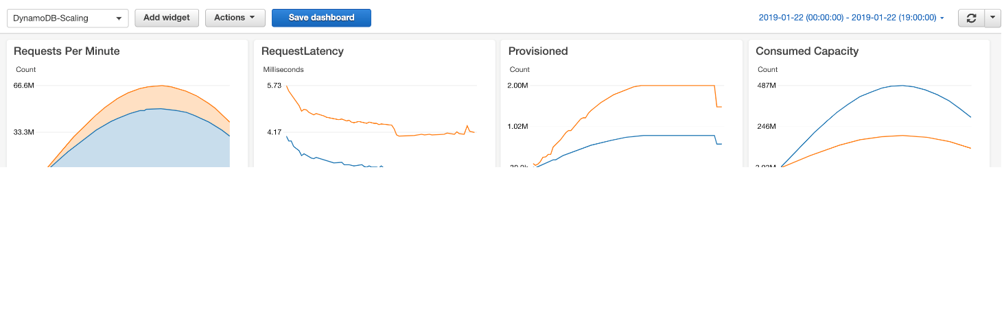

Single-digit-millisecond latency at petabytes of scale Performance at scale
Millions of requests per second
Trillions of items
Petabytes of storage
Single-digit-millisecond read and write latencies
Notes:
DynamoDB has experienced some extreme scale in real-world scenarios (e.g. Prime Day, Cyber Monday). Though many AWS customers will not require this level of scale, it is nice to know that DynamoDB is regularly battle hardened well beyond the requirements of your business. Ad-Tech applications typically require extremely low latency, which is well suited for DynamoDB’s low single digit millisecond read and write performance. Mobile applications and consumer voting applications often have millions of users and need to handle thousands of requests per second. DynamoDB can scale horizontally to meet this load. Finally, application monitoring solutions typically ingest hundreds of thousands of data points per minute, and DynamoDB’s schema-less data model, high IO performance and support for a native JSON data type is a great fit for these types of applications.

Slide 18
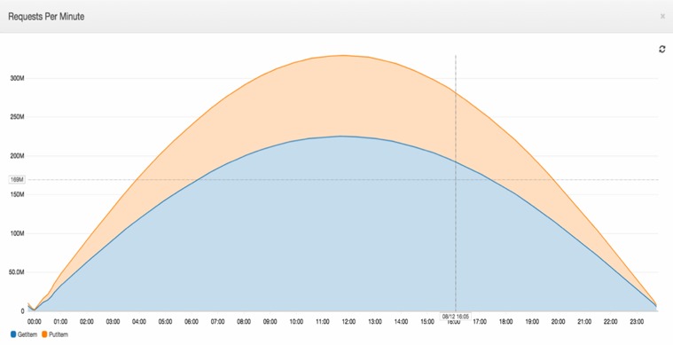
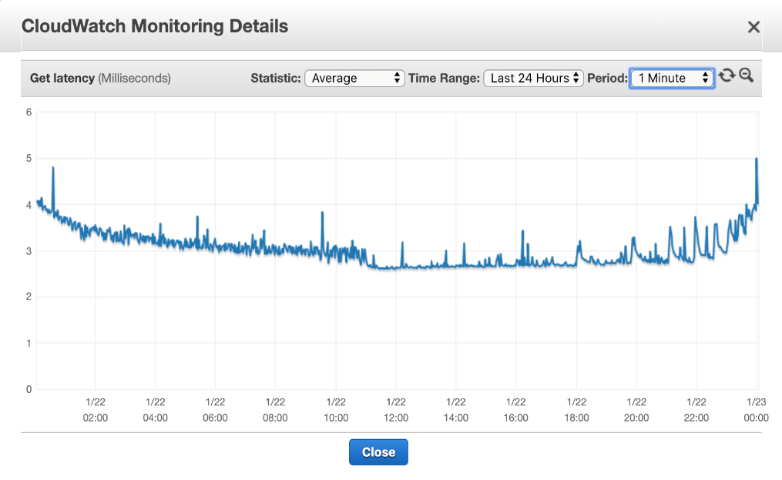
Consistently low latency, even during high request volume Performance at scale
High request volume
Consistently low latency
Millions of requests per second
Only 1 millisecond variance
Notes:
DynamoDB provides not only high throughput, but also consistent and predictable responsiveness. However, for some customers in Finance and AdTech, even milliseconds may not be good enough. We noticed they started using caching technologies, so we built them into DynamoDB (see next slide).

Slide 19

Global tables provide apps with multi-Region replication Performance at scale
Build high-performance, globally distributed applications
Low-latency reads and writes to locally available tables
Multi-Region redundancy and resiliency and 99.999 percent availability
Multi-active writes from any Region
Easy to set up and no application rewrites required
Notes:
Global tables build on DynamoDB’s global footprint to provide you with a fully managed, multi-region, and multi-master database that provides fast, local, read and write performance for massively scaled, global applications. Global tables replicate your DynamoDB tables automatically across your choice of AWS Regions. Global tables eliminate the difficult work of replicating data between regions and resolving update conflicts, enabling you to focus on your application’s business logic. In addition, global tables enable your applications to stay highly available even in the unlikely event of isolation or degradation of an entire Region.

Slide 20


DynamoDB Accelerator (DAX) adds read cache Performance at scale
Your applications
Fully managed, highly available cache for DynamoDB
Even faster—microsecond latency
Scales to millions of read requests per second
API compatible
DAX
DynamoDB
Notes:
For even more performance, Amazon DynamoDB Accelerator (DAX) is a fully managed, highly available, in-memory cache for DynamoDB, that delivers up to a 10x performance improvement—from milliseconds to microseconds—even at millions of requests per second. DAX does all the heavy lifting required to add in-memory acceleration to your DynamoDB tables, without requiring developers to manage cache invalidation, data population, or cluster management. Now you can focus on building great applications for your customers without worrying about performance at scale. You do not need to modify application logic, because DAX is compatible with existing DynamoDB API calls.

Slide 21
Amazon Kinesis Data Streams for DynamoDB Performance at scale
New integration: Capture item-level changes in your DynamoDB tables as a Kinesis data stream.
Advanced streaming applications with reduced complexity: Build real-time applications by using Amazon Kinesis Data Analytics and stream processing frameworks such as Apache Spark or your code by using the latest versions of the Kinesis Client Library.
Work with other AWS services: Use Amazon Kinesis Data Firehose to transform and send streaming data to destinations such as Amazon OpenSearch Service, Amazon Redshift, Amazon S3, and Splunk.
Notes:
New integration: Capture item-level changes in your DynamoDB tables as a Kinesis data stream.
Advanced streaming applications, reduced complexity: Build real-time applications by using Amazon Kinesis Data Analytics, and stream processing frameworks such as Apache Spark or your code by using the latest versions of the Kinesis Client Library.
Working with other AWS services: Use Amazon Kinesis Data Firehose to transform and send streaming data to destinations such as Amazon Elasticsearch Service, Amazon Redshift, Amazon S3, and Splunk.

Slide 22
DynamoDB supports business growth and helps customers Performance at scale
Future proof: Handle a 10-times growth cycle without any upfront outlay.
Improve the customer experience: Achieve better performance and uptime for your massive scale, mission-critical applications that your customers depend upon.
Reduce risk: Avoid scaling challenges for your mission-critical applications where downtime equates to lost revenue.

Slide 23
Why Amazon.com depends on DynamoDB for performance at scale

Slide 24


Retail
The internal Amazon.com Herd system supports hundreds of millions of active workflows.
Migrated from Oracle to DynamoDB
Improved customer experience: Workflow processing delays dropped from 1 second to 100 milliseconds.
Reduced cost: Scaling and maintenance effort dropped 10 times.
Reduced complexity and risk: Retired more than 300 Oracle hosts.
Amazon DynamoDB supports multiple high-traffic sites and systems including Alexa, the Amazon.com sites, and 442 Amazon fulfillment centers. Across the 66-hour 2020 Prime Day, these sources made 16.4 trillion calls to the DynamoDB API, peaking at 80.1 million requests per second.
Notes:
And yes, we are seeing customers such as Amazon.com migrate off even the old gold standard of RDBMS, Oracle. As we discussed earlier, even if Oracle can scale for you, it is VERY costly and isn’t conducive for a DevOps model.

Slide 25
No servers to manage

Slide 26
Getting back valuable time for your business No servers to manage
As a fully managed database service, DynamoDB does the heavy lifting for you across:
Security
Operating-system patching
Database patching
Access control
Audit
Encryption
Compliance
Availability
High availability configuration
Monitoring
Cross-Region replication
Performance
Performance tuning
Indexing
In-memory caching
Durability
Sustain server, rack, and datacenter outages
Re-replicate data quickly upon hardware failure
Manage backup and restore
Scalability
Host provisioning
Host repair and retirement

Slide 27
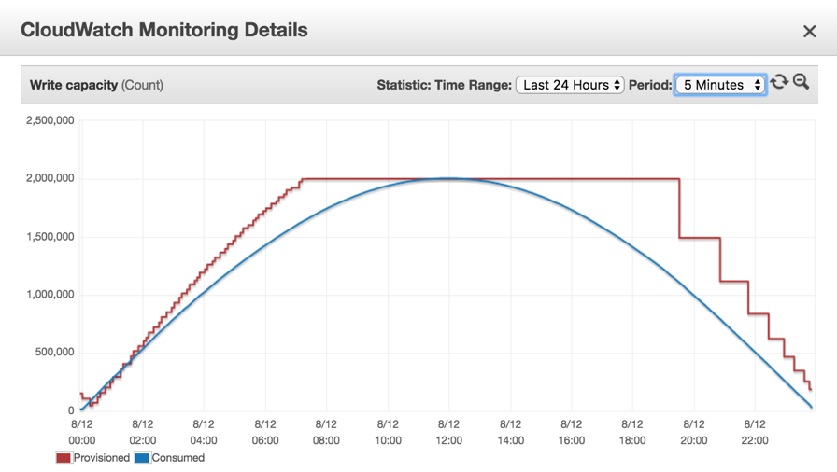
Provisioned capacity mode: auto scaling and maintain performance No servers to manage
Automated scaling policies
Scales up when you need it
Scales down when you don’t
Scheduled auto scaling
$$$ Savings
PROVISIONED CAPACITY MODE
Notes:
Here’s a CloudWatch monitoring view of provisioned capacity and usage. In most DBs (relational or NoSQL), you’d provision way high, hoping that you don’t approach your capacity line. Capacity set too low = Availability impact. Capacity set too high = Financial waste. You can’t win! With DynamoDB auto scaling, set it and forget it.

Slide 28
On-demand capacity mode: rapid, flexible scaling No servers to manage
No capacity management
Ideal for unpredictable workloads
Pay only for what you use
No need to specify how much read/write throughput you expect to use
Ramp from zero to tens of thousands of requests per second on demand
Pay-per-request pricing
28
Notes:
DynamoDB on-demand is a flexible new billing option for DynamoDB capable of serving thousands of requests per second without capacity planning. DynamoDB on-demand offers simple pay-per-request pricing for read and write requests so that you only pay for what you use, making it easy to balance costs and performance. For tables using on-demand mode, DynamoDB instantly accommodates customers’ workloads as they ramp up or down to any previously observed traffic level. If the level of traffic hits a new peak, DynamoDB adapts rapidly to accommodate the workload.

Slide 29
Reap the benefits of a fully managed NoSQL database No servers to manage
Reduce risk
Never run out of capacity again
Protect your data with managed backup and restore, point-in-time recovery, and global tables
Reduce cost
Reduce database operational support
Infrastructure is expensive to scale
Enterprise license costs can add up quickly
Never pay for unused capacity again
Move faster
Operations will never slow you down again
Immediately provision massive amounts of capacity without touching a server
Stop wasting time on capacity forecasts that are seldom accurate anyway
Never worry about which version of DynamoDB you’re using; you’ll always be on the latest and greatest

Slide 30
How Samsung has simplified operations and reduced risk through serverless DynamoDB

Slide 31


Software and internet
Mission-critical use case: Backup and restore on mobile app for 300 million users
Migrated from Cassandra to DynamoDB:
70 percent cost savings by greatly reducing operational maintenance
More stable, lower risk from DynamoDB consistent performance
Meets greater and growing scale to fulfill all customer demand with almost 1 PB in DynamoDB, 130 million daily API requests
“
“
DynamoDB provided consistent high performance at a drastically lower cost than Cassandra.
—Seongkyu Kim
Samsung
Notes:
We’re seeing a big swing in customers looking to move Cassandra-based workloads to DynamoDB. It makes sense because the two are similar. We routinely hear from CTOs who say that things started well on Cassandra, but managing at scale is costly and complex. It’s particularly difficult to find the expertise to support Cassandra. Samsung used to have a number of people maintaining a Cassandra cluster. After migrating to DynamoDB, those people now focus on the mobile app and not on the database.

Slide 32
Enterprise ready

Slide 33
Native, server-side support for ACID transactions Enterprise ready
Simplify application code with ACID guarantees
Run transactions for large-scale workloads
Accelerate legacy migrations
33
Notes:
DynamoDB transactions provide developers atomicity, consistency, isolation, and durability (ACID) across one or more tables within a single AWS account and region. You can use transactions when building applications that require coordinated inserts, deletes, or updates to multiple items as part of a single logical business operation. DynamoDB is the only non-relational database that supports transactions across multiple partitions and tables.

Slide 34
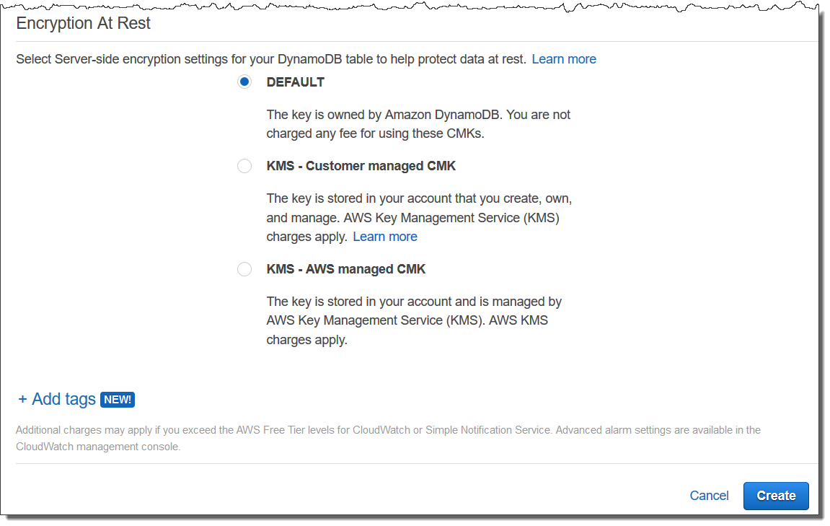
Security: Access controls and encryption at rest Enterprise ready
Fully integrated with AWS Identity and Access Management (IAM)
Access DynamoDB via secure Amazon VPC endpoints
All tables encrypted in transit and at rest by default
Notes:
Encryption at rest helps you secure your Amazon DynamoDB data by supporting both AWS managed and customer-managed encryption keys stored in AWS Key Management Service (AWS KMS). Encryption at rest is fully transparent to users with all DynamoDB queries working seamlessly on encrypted data without the need to change application code.

Slide 35
Security: Audit logging with AWS CloudTrail Enterprise ready
Capture and log all control-plane operations (such as CreateTable, ListTable) and data-plane operations (such as GetItem, PutItem, DeleteItem, Query) across your DynamoDB resources for governance and auditing
Enable compliance, operational, and risk auditing
Record table-level and item-level activity, initiate actions when important events are detected, and analyze events and logs with Amazon Athena or CloudWatch Logs Insights
Compliance aid
Visibility into activity
Detect data exfiltration
Automate security analysis
Troubleshoot anomalies
Analyze permissions
Notes:
AWS CloudTrail is a service that enables governance, compliance, operational auditing, and risk auditing of your AWS account. With CloudTrail, you can log, continuously monitor, and retain account activity related to actions across your AWS infrastructure. CloudTrail provides event history of your AWS account activity, including actions taken through the AWS Management Console, AWS SDKs, command line tools, and other AWS services. Once enabled you get a CloudTrail with all Management Events automatically and at no charge. Then you also have several different data plane event sources that you can opt in to depending on your particular application and compliance needs. This event history is yet another source of observability data that we provide which simplifies security analysis, resource change tracking, and troubleshooting.
Visibility into what is happening in your environment is crucial.
Who is using my resource?
Did they modify it?
When did they access it?
Where did they login from?
Was it during my maintenance window?
Who were active users during an incident?
What events occurred during a time period?
What actions did AWS take on my behalf?
… and many more

Slide 36
Backup and restore Enterprise ready
Simplify backup operations
Ensure compliance & security
Disaster Recovery
Automate backup scheduling, retention management and life cycle management
On-demand backups for long-term data archiving and compliance
Continuous backups for point-in-time recovery (PITR)
Centrally enforce backup policies & audit backup activity across AWS services*
Backup to other AWS accounts and Regions for disaster recovery planning*
Back up PBs of data with no performance impact
Simplify cost allocation across backup operations with tagging*
Secure backups with separate backup encryption – use a CMK or a service-specific default key*
Define cold storage lifecycle preferences to optimize backup costs*
** To use these enhanced backup features, you need to opt-in to have the AWS Backup service manage your DynamoDB on-demand backups.
Notes:
On-demand backup allows you to create full backups of your DynamoDB tables’ data for data archiving, helping you meet your corporate and governmental regulatory requirements. You can back up tables from a few megabytes to hundreds of terabytes of data, with no impact on performance and availability to your production applications. On-demand backup processes back up requests in seconds regardless of the size of your tables so that you don’t have to worry about backup schedules or long-running processes. In addition, you can enable continuous backups for point-in-time recovery. This gives you the ability to restore to any point in the last 35 days down to the per second granularity. All backups are automatically encrypted, cataloged, easily discoverable, and retained until you explicitly delete them. You can execute backup and restore operations with a single click in the AWS Management Console or with a single API call.
Quick summary of AWS Backup
AWS Backup is a fully managed backup service that makes it easy to centralize and automate data protection and the backing up of data across AWS resources.
You can create backup policies and plans, you tag them, you can use these plans to define your backup requirements, like frequency and retention and expiration of all those backup copies. And you do all this in a policy-based way.
AWS Backup enables customers to centralize and automate data protection across AWS services. AWS Backup offers a cost-effective, fully-managed, policy-based service that further simplifies data protection at-scale. AWS Backup also helps customers support their regulatory compliance obligations and meet business continuity goals. Together with AWS Organizations, AWS Backup centrally deploys data protection (backup) policies to configure, manage, and govern your backup activity across your organization’s AWS accounts and resources, including Amazon EC2 instances, Amazon EBS volumes, Amazon Relational Database Service (RDS) databases (including Aurora clusters), Amazon DynamoDB tables, Amazon Elastic File System (EFS), Amazon FSx for Lustre, Amazon FSx for Windows File Server, and AWS Storage Gateway volumes.”
DynamoDB customers can opt-in to use AWS Backup service to manage on-demand backups. Customers now can define cross-account and cross-Region backup copy preferences enabling them to support their regulatory compliance or business policies for data protection. They also can tag on-demand backups to simplify cost allocation and define cold storage lifecycle preferences to reduce backup costs. The new on-demand backups will be encrypted using AWS Key Management Service (KMS) key on your AWS Backup vault.

Slide 37



NoSQL Workbench Enterprise ready
A client-side application that helps you build scalable, high-performance data models
Simplifies query development and testing
A rich GUI-based tool that helps you visualize data models and perform DynamoDB operations
Available for Windows, macOS, and Linux
Data modeler
Visualizer
Operation builder
Notes:
NoSQL Workbench for Amazon DynamoDB is a cross-platform client-side application for modern database development and operations and is available for Windows and macOS. NoSQL Workbench is a unified visual tool that provides data modeling, data visualization, and query development features to help you design, create, query, and manage DynamoDB tables.
Data Modeler: With NoSQL Workbench for DynamoDB, you can build new data models from scratch, or design models based on existing data models that satisfy your application's data access patterns. You can also import and export the designed data model at the end of the process.
Visualizer: The data model visualizer provides a canvas where you can map queries and visualize the access patterns (facets) of the application without having to write code. Every facet corresponds to a different access pattern in DynamoDB. You can manually add data to your data model or import data from MySQL.
Operation Builder: NoSQL Workbench provides a rich graphical user interface for you to develop and test queries. You can use the operation builder to view, explore, and query datasets. You can also use the structured operation builder to build and perform data plane operations. It supports projection and condition expression, and lets you generate sample code in multiple languages. It lets you run queries and get the result for them. It lets developers connect to their DynamoDB account and then perform operations like Scans, Query, Put, Update, Delete, TransactWrite, TransactGet, BatchWrite and BatchGet on their tables and GSI.

Slide 38
Export DynamoDB data to S3 for analysis and insights Enterprise ready
Extract actionable insights
Work across Regions
Export DynamoDB table data to your data lake in Amazon S3, then use other AWS services to analyze data and highlight key takeaways.
Export data to S3 across AWS Regions and accounts to help comply with regulatory requirements, and to develop a disaster recovery and business continuity plan.
Integrate with backups
No impact on performance
To export, select a DynamoDB table that has point-in-time recovery (PITR) enabled, specify any point in the last 35 days, and choose the target Amazon S3 bucket. The output data formats supported are DynamoDB JSON and Amazon Ion.
Does not consume table capacity, and has zero impact on performance and availability. All DynamoDB data added to your Amazon S3 data lake is easily discoverable, encrypted at rest and in transit, and retained in your S3 bucket until you delete it.
Notes:
Extract actionable insights: Export DynamoDB table data to your data lake in Amazon S3, and use other AWS services such as Amazon Athena, Amazon SageMaker, and AWS Lake Formation to analyze data and highlight key takeaways.
Integration with backups: To export, select a DynamoDB table that has point-in-time recovery (PITR) enabled, specify any point in last 35 days, and choose the targe Amazon S3 bucket. The output data formats supported are JSON and Amazon Ion.
Work across regions: You can use this feature to export data to S3 across AWS Regions and accounts to help comply with regulatory requirements, and to develop a disaster recovery and business continuity plan.
Impact and performance: New feature does not consume table capacity, zero impact on performance and availability. All DynamoDB data added to your S3 data lake is easily discoverable, encrypted at rest and in transit, and retained in your S3 bucket until you delete.

Slide 39
PartiQL now supported on DynamoDB for easier queries Enterprise ready
Easier queries
Improved productivity
Use PartiQL (a SQL-compatible query language) to query, insert, update, and delete table data in the DynamoDB console, SDK, and AWS CLI.
Because PartiQL is supported for all data-plane operations, developers can use a familiar, structured query language to perform these operations.
Consistent performance
Supported across AWS Regions
With PartiQL, DynamoDB continues to provide consistent, single-digit-millisecond latency at any scale. You can expect the same availability, latency, and performance when performing DynamoDB operations.
PartiQL for DynamoDB is now supported in 23 AWS Regions.
Notes:
You now can use PartiQL (a SQL-compatible query language)—in addition to already-available DynamoDB operations—to query, insert, update, and delete table data in Amazon DynamoDB.
PartiQL makes it easier to interact with DynamoDB and run queries in the AWS Management Console.
Because PartiQL is supported for all DynamoDB data-plane operations, it can help improve the productivity of developers by enabling them to use a familiar, structured query language to perform these operations.
With PartiQL, DynamoDB continues to provide consistent, single-digit-millisecond latency at any scale.
You can expect the same availability, latency, and performance when performing DynamoDB operations.
The DynamoDB Service Level Agreement continues to apply while you use PartiQL to perform operations on DynamoDB table data.
PartiQL—a SQL-compatible query language—for Amazon DynamoDB is now supported in the following 23 AWS Regions: US East (N. Virginia), US East (Ohio), US West (Oregon), US West (N. California), Canada (Montreal), South America (Sao Paulo), Europe (Ireland), Europe (Frankfurt), Europe (London), Europe (Milan), Europe (Paris), Europe (Stockholm), Africa (Cape Town), Asia Pacific (Hong Kong), Asia Pacific (Mumbai), Asia Pacific (Osaka-Local), Asia Pacific (Seoul), Asia Pacific (Singapore), Asia Pacific (Sydney), Asia Pacific (Tokyo), China (Beijing), China (Ningxia), and Middle East (Bahrain).
For more information about using PartiQL with DynamoDB, see PartiQL – A SQL-Compatible Query Language for Amazon DynamoDB.

Slide 40
Helping your business move faster and unlock innovation Enterprise ready
Unlock innovation
Move faster
Enterprises can finally meet the scale requirements of digital transformation projects that would otherwise break legacy databases.
Enterprise customers can turn on new tables or scale existing ones at the speed of a startup.
Reduce risk
Eliminate versioning
Avoid scaling challenges for your mission-critical applications where downtime equates to millions of lost dollars. Use the same technology that Amazon.com relies on for its uptime, which is backed by an industry-leading SLA.
With DynamoDB, you’re always on the latest version. We typically update at least one component of DynamoDB every weekday. Enterprises always have the latest security, durability, availability, and performance improvements.

Slide 41
How Capital One increased their speed of innovation because of enterprise-ready DynamoDB

Slide 42

Banking and finance
Capital One completed migration from data centers to AWS in 2020, becoming the first US bank to go all in on the cloud
Migrated from mainframe to DynamoDB:
Previously all apps were served by a single mainframe sitting in the middle of their physical business
Product teams busy coming up with new mobile products for customers were often blocked by the mainframe
DynamoDB and microservices give app developers unbounded scale, nimbleness, and the ability to roll out all new services
“
“
The new solution is so much faster...with an average response time of 55 ms.
—Srini Uppalapati
Capital One
Notes:
We’re also seeing customers looking to move their mainframe workloads to DynamoDB. Financial customers such as CapitalOne are benefiting from moving to a flexible and highly scalable database like DynamoDB integrated into their serverless architecture on AWS, and was able to focus on building faster applications with reduced latency for better user experience.
Latest case study (2020) – All in AWS - https://aws.amazon.com/solutions/case-studies/capital-one-all-in-on-aws/

Slide 43
Customer stories

Slide 44




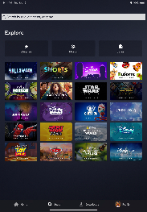


Media and entertainment
Disney+ launched in November 2019 and delivers its extensive library of digital content directly to the homes of over 60.5 million subscribers, and DynamoDB is one of the technologies that supports this global footprint.
Disney+ chose DynamoDB to help with:
Utilizing multi-Region replication with single-digit latency to shift traffic without experiencing data issues
Adding another AWS Region in global tables to launch into new countries, providing low latency
Scaling Recommendations and Bookmarks with little to no operational overhead
Having the ability to switch back and forth between on-demand and provisioned capacity modes when entering new Regions
“
“
Billions of bookmarks ingested a day over Amazon Kinesis and into Amazon DynamoDB.
—Attilio Giue
Director of Content Discovery, Disney+
Notes:
Disney+, one of the largest global online video streaming platforms, was launched in November 2019 as the home of Disney, Pixar, Marvel, Star Wars, and National Geographic.
Re:Invent 2020 session - https://virtual.awsevents.com/media/1_1fk94c1l
Utilizing multi-Region replication with single-digit latency that allows Disney+ to shift traffic without experiencing data issues
Adding another AWS Region in global tables as Disney+ launches into new countries, which provides low latency
Scaling Recommendations and Bookmarks supported by DynamoDB global tables with little to no operational overhead
Having the ability to switch back and forth between on-demand and provisioned capacity modes when entering new Regions

Slide 45


Media and entertainment
Netflix uses DynamoDB as a massive-scale metadata store for A/B testing
Netflix selected DynamoDB for operational resiliency:
They operate their DynamoDB metadata store across multiple AWS Regions
Chose DynamoDB to handle Netflix scale:
Netflix runs hundreds of A/B tests at any given time and DynamoDB can handle that scaling up and down
Across millions of user accounts
Selected DynamoDB for performance:
Netflix requires low latency across millions of JSON documents

Slide 46


Media and entertainment
A+E has made going fully serverless and adopting a cloud-native, microservices-driven architecture a top priority. Access is one of their new cloud-native apps that indexes A+E programs and related content.
A+E chose AWS and DynamoDB:
To build Access on the serverless DynamoDB, with search results primarily served up through Amazon ElastiCache, which works as an in-memory data store and cache supporting submillisecond response times.
To achieve things that would have been mostly impossible or cost prohibitive without DynamoDB’s serverless architecture.
“
We always joke around that it’s cheaper than getting a latte to run Access for a day using Amazon DynamoDB, if you exclude video.
—Jeffrey McGrath
VP of Data Analytics and DevOps, A+E Networks
“
Notes:
A+E case study - https://aws.amazon.com/solutions/case-studies/ae-networks-databases-case-study/

Slide 47

Software and internet
Dropbox experienced a capacity crunch in its on-premises metadata store due to fast data growth. They had less than two years until their on-premises system would reach maximum capacity, so they pursued a fully managed cloud solution with AWS.
Dropbox chose DynamoDB and Amazon S3:
To migrate audit log data from a legacy database in less than two weeks, and launch metadata storage system in one year
To scale for virtually unlimited user metadata, with high performance, ingesting data during migration of up to 600k queries per second
To save millions of dollars in expansion costs and to reduce per-user gigabyte costs by a factor of 5.5
“
When building a storage system, you have to think about components like replication, backups, and capacity management. By using DynamoDB and Amazon S3, we simplify these problems because AWS handles many of the complex tasks.
—Jonathan Lee
Tech Leader, Dropbox
“
Notes:
Dropbox AWS case study - https://aws.amazon.com/solutions/case-studies/dropbox-dynamodb-case-study/
Dropbox re:Invent 2020 session - https://virtual.awsevents.com/media/1_9qr7wzqh
With more than 600 million registered users across 180 countries, Dropbox is on a mission to design a more enlightened way of keeping work moving and providing one place to keep life organized.

Slide 48
Software and internet
From zero to 40 billion links with DynamoDB
Challenges
Increasing costs, risk of data loss, and challenges scaling self-managed PostgreSQL database on Amazon EC2 as overall traffic scaled 100 times.
Solution
Migrated from PostgreSQL on Amazon EC2 to
DynamoDB and DAX.
Benefits
Reduced costs by one-third compared to legacy system.
Has 3x replication in multiple Availability Zones (compared to 2x in a single Availability Zone for the legacy system).
Scaled I/O throughput up 40x+ as needed in minutes.
Predictable runway for at least another 10x growth cycle
Branch is a mobile linking platform that builds high-quality user experiences with best-in-class deep linking, all while measuring the complete journey of users.
Notes:
https://medium.com/branch-engineering/from-zero-to-40-billion-links-our-journey-migrating-to-dynamodb-4ce598926382

Slide 49



Software and internet
Snap tackles massive-scale spikes
Migrated its Snapchat Stories from a legacy cloud database to DynamoDB to help:
Mitigate risk
This is now “one of the most stable systems at Snapchat.” –Dave Killian, Snap Infrastructure Engineering Lead
Reduce cost
Eliminated millions of dollars of over-provisioning cost per year compared to the legacy system
Tackle scale
New Year’s Eve is the app’s largest spike of the year and DynamoDB gracefully served the drastic increase in traffic

Slide 50


Software and internet
Profile, match, and swipe data
25 TB data, 20 billion matches, 190 countries
Migrated from MongoDB to DynamoDB with 60 percent cost savings
“
“
DynamoDB helps us achieve greater developer efficiency…at a lower cost.
—Jun-young Kwak
Tinder

Slide 51


Software and internet
Serving more than three billion GIFs a day to more than 300 million daily active users
Migrated from MySQL to DynamoDB:
MySQL had a scaling bottleneck
DynamoDB automatically scales as the business grows
Improvement in read responsiveness by 25 percent and in overall system performance
“
For any company experiencing rapid user growth, scaling data can be a hard and daunting task. In our case, Amazon RDS with a DynamoDB/DAX solution was the perfect combination to alleviate our growing pains.
—Nima Khoshini
GIPHY
“

Slide 52



Manufacturing
Siemens uses AWS to reduce power plant alerts by 90%
Challenges
A modern power plant control system receives about 5,000 alerts a day about component failures, but monitoring teams can analyze only 500 of them.
Solution
AWS Lambda for analyzing power plant process-control data, Amazon S3 for object storage, Amazon SQS for fully managed message queueing, and DynamoDB to hold the results of analytics processes that run based on data held in Amazon S3.
Benefits
Ability to prototype the serverless platform and application in three months, reduce customers’ alerts by 90 percent, and reduce infrastructure costs by 85 percent, with no downtime in the first year.
"With the serverless AWS platform, we decreased customer control system alerts [by] 90 percent and reduced infrastructure costs [by] 85 percent.”
-Stefan Lichtenberger, Program Manager, Siemens Gas and Power
Notes:
https://aws.amazon.com/solutions/case-studies/siemens-ic/

Slide 53

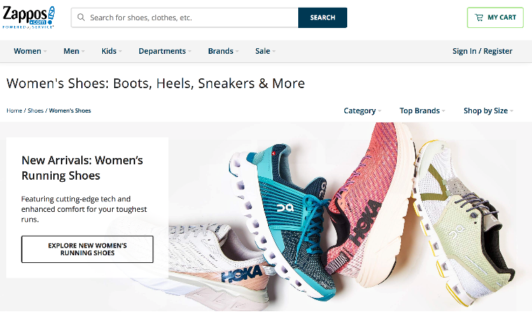
Retail
Zappos creates breakthrough customer
experiences by using AWS
Challenges
Ability to make personalized recommendations at runtime to increase search relevance without slowing down search performance.
Solution
Zappos combined high-performance caching (Amazon ElastiCache), strategic precalculation of certain results (DynamoDB), and ensemble-based machine learning approaches that use multiple, simple models (Amazon Kinesis Data Firehose, Amazon Redshift, and Amazon SageMaker).
Benefits
Search latency is below 48 milliseconds for 99 percent of searches. Achieved higher search-to-clickthrough rates and searches are personalized for better customer experiences. Also there are fewer returns because of improved sizing recommendations.
“We needed to minimize the amount of time the extra operations take. So we combined high-performance caching, strategic pre-calculation of certain results, and ensemble-based machine learning approaches that use multiple, simple models.”
– Ameen Kazerouni, Head of Machine Learning Research and Platforms, Zappos
Notes:
https://aws.amazon.com/solutions/case-studies/zappos-case-study/?did=cr_card&trk=cr_card

Slide 54



Banking and finance
Vanguard’s mainframe modernization with DynamoDB
Previously all of Vanguard’s web apps were served by a single mainframe:
Risky to have this mainframe at the core of their business
Constrained innovation
Expensive
DynamoDB for transactional data moved them to a microservices arch:
Now Vanguard can move much faster
Eliminated single point of failure risk
Managed services allow them to focus on their business, not infrastructure
Enables a continuous deployment pipeline for the first time
System is secure and meets compliance

Slide 55
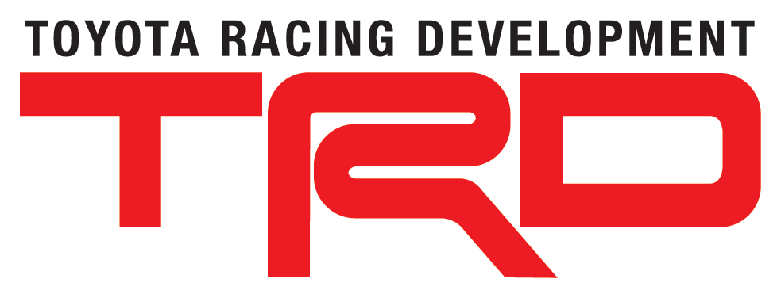


Automotive
Toyota Racing Development (TRD) makes racing decisions with DynamoDB
DynamoDB is the backend datastore for:
Prerace data models that predict optimal adjustments for cars before races start
Real-time race data pulled from the cars to guide split-second decisions about pitting, tire changes, and other strategic race decisions
Why did TRD choose DynamoDB?
Managed service means zero maintenance
DynamoDB effortlessly scales to handle many data sources
Data is persisted for future queries
Microservices architecture to continually and rapidly add new data analyses

Slide 56


Automotive
Lyft chose DynamoDB:
To handle massive scale and bursts gracefully:
In more than 200 cities, more than 14 million rides per month, 8 times traffic during peak hours
For mission-critical transactional data:
The GPS location of all rides is tracked in the ride location-tracking system
To handle rapid growth cycles with a small team:
Deployed location-tracking system on DynamoDB
“
“
DynamoDB is so simple to scale out. We only have two knobs. One for reads and one for writes.
—Chris Lambert
CTO, Lyft

Slide 57



Education
Duolingo uses AWS databases to serve up more than 31 billion items for 80 language courses with high performance and scalability
Primary database: Amazon DynamoDB
24,000 reads and 3,000 writes per second
Personalized lessons for users taking 6 billion exercises per month
In-memory caching: Amazon ElastiCache
Instant access to common words and phrases
Transactional data: Amazon Aurora
Maintain user data
“
We have over 31 billion items in our largest DynamoDB table, and that table executes over 24,000 read units per second and over 3,000 write units per second without breaking a sweat.
—Karin Tsai
Duolingo
“
Notes:
Duolingo uses Amazon DynamoDB as one of its primary database solutions. Each second, Duolingo’s DynamoDB implementation supports 24,000 reads and 3,000 writes, personalizing lessons for users taking 6 billion exercises per month. And Amazon DynamoDB provides autoscaling, which intelligently adjusts performance based on user demand—ensuring high availability and minimizing wasted costs due to over-provisioning. Duolingo also uses Amazon ElastiCache to provide instant access to common words and phrases, Amazon Aurora as the transactional database for maintaining user data, and Amazon Redshift for data analytics. With this database backbone, Duolingo teaches more language students than the entire US school system.

Slide 58
Challenges
Their legacy environment was good for analytics but not for single-key lookup.
Solution
PennyPop uses DynamoDB to store all player and game data.
Benefits
DynamoDB allowed PennyPop to launch with only a few requests per minute, scale to more than 80,000 requests per second, and support its global player community by deploying to multiple Regions on AWS.
They saved at least 50 percent per year when compared to hosting and sharding their own relational database.
The company would have also needed to double its operations staff from three to six server engineers to run the same environment on premises.
Gaming
“Using Amazon DynamoDB frees us from building, maintaining, and sharding large, real-time, data-intensive projects.”
- Charles JuCo-Founder, PennyPop
Notes:
https://aws.amazon.com/solutions/case-studies/adroll/

Slide 59


Gaming
The Pokémon Company migrated to AWS purpose-built databases.
In the process, they migrated global configuration and time-to-live (TTL) data to DynamoDB.
Their monthly database cost has dropped by tens of thousands of dollars.
They had 68 hours of downtime or performance degradation in the six months before migration. After? Zero.
“
Using the built-in TTL settings in DynamoDB, we can track when a user exceeds the maximum login attempt threshold and deny entry. The result has been a 90 percent reduction in bot login attempts, which frees up system resources for legitimate users and reduces our need to overscale.
– Jeff Webb
The Pokémon Company
“
Notes:
Pokemon case study - https://aws.amazon.com/solutions/case-studies/the-pokemon-company-case-study/

Slide 60

Ad tech
Massive scale ad targeting and machine learning
Started at ~125,000 reads/sec and ~40,000 writes/second and increased significantly from there.
Migrated from Cassandra to DynamoDB
65-70 percent cost savings (TCO)
“This was a big win for us considering the fact that there will be no additional infrastructure to run and no more maintenance activities required from an engineer’s end.”
—Anirban Roy
GumGum
Notes:
We also are seeing customers looking to migrate from MongoDB to DynamoDB. These customers tell us MongoDB can be difficult to get very high availability and extreme scale, and it’s hard to operate at scale. DynamoDB provides developers better efficiency at a lower cost.

Slide 61
Get started today with DynamoDB
Major languages supported through the AWS SDK such as Java, .NET, Python, Node.js, and Go
Use AWS Database Migration Service (DMS) to migrate your data to DynamoDB
Visit DynamoDB.com
Follow @DynamoDB on

Slide 62
Appendix

Slide 63
AWS Glue Elastic Views: Use DynamoDB as a source data store Available in limited preview (Dec 2020)
Build materialized views: AWS Glue Elastic Views makes it easy to build materialized views using SQL, without having to write custom code.
Automatically copies data: After creating a virtual table—called a view—from DynamoDB, AWS Glue Elastic Views copies data and creates a replica—called a materialized view—in a target data store.
Serverless: AWS Glue Elastic Views scales capacity up or down automatically based on demand, so there’s no infrastructure to manage.
Works with other AWS services: With DynamoDB as a source, you can materialize views in Amazon Elasticsearch Service, Amazon S3, and Amazon Redshift.
63
Notes:
Use DynamoDB as source data store: AWS Glue Elastic Views makes it easy to built materialized views using SQL, without having to write custom code.
Automatically copies data: After creating a virtual table – called a view – from DynamoDB, AWS Glue Elastic Views copies data and creates a replica – called a materialized view – in a target data store.
Serverless: AWS Glue Elastic Views scales capacity up or down automatically based on demand, so there’s no infrastructure to manage.
Works with other AWS services: AWS Glue Elastic Views also supports Amazon S3, Amazon Redshift, and Amazon Elasticsearch Service. Available in preview.

Slide 64
Thank you!

